Slide 1

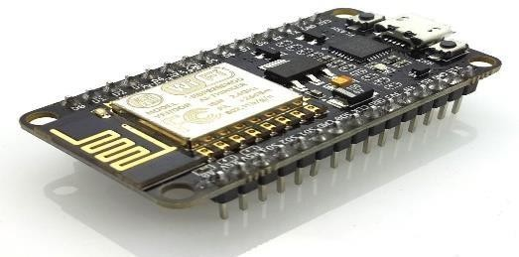
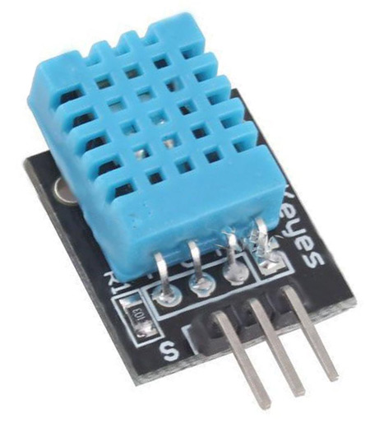
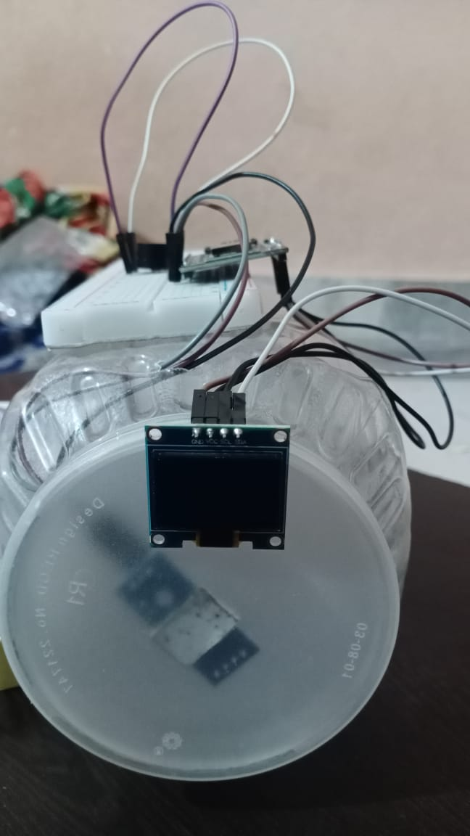
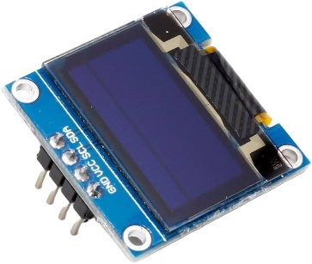
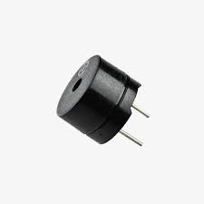
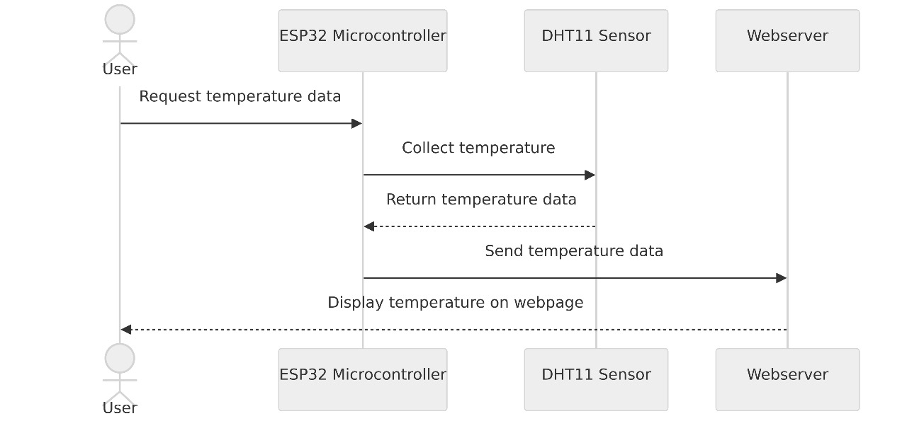
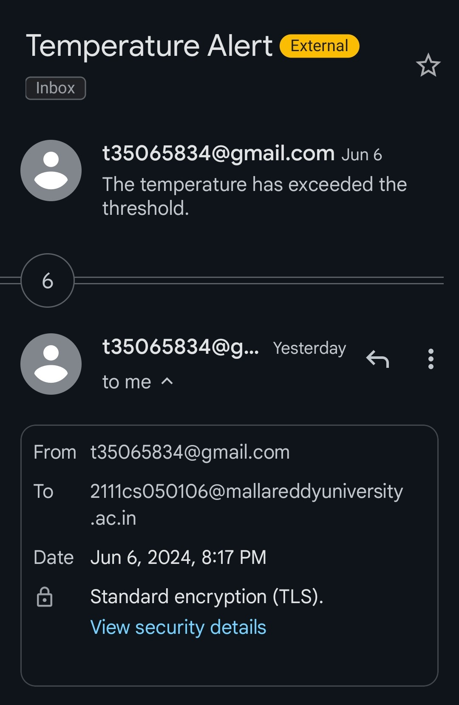
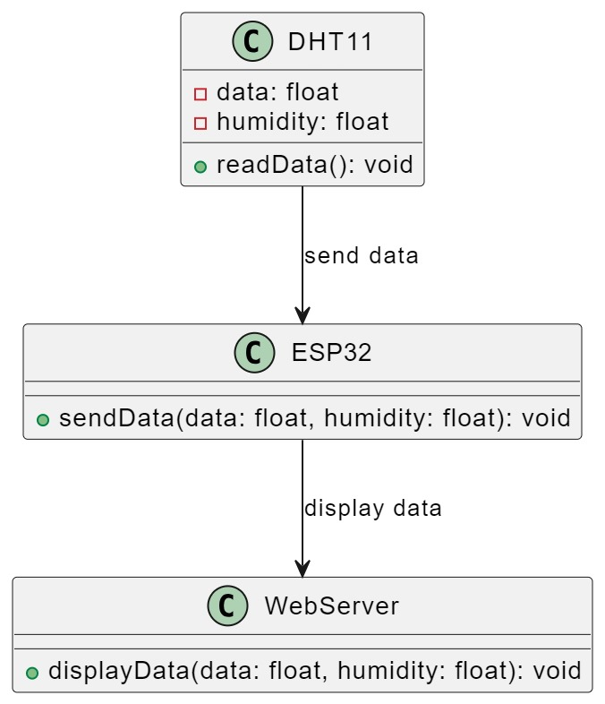
COLD STORGE DEVICE
3rd year Department of IOT
ABSTRACT
MATERIALS & METHODS
RESULTS
CONCLUSION
Iot technology has enabled the development of useful application to improve the quality of life. We can also the need to develop other application to make an effective use of the devices and the internet connectivity. Our project try’s to solve the problems occuring due to lack of monitoring of our goods. In this regard we have taken the first to solve the problem by proposing a project which can Monitor the temperature of goods present in an container and notify the person in-charge according to the constraints he/she have provided .For this project we will be using ESP32 as the processing unit due to wireless wifi connectivity and upload HTML code to monitor temperature and daily usage of our model through the local network connected to the device.
Components:-
ESP32 DHT11
OLED BUZZER
We use these sensors and actuator to create our smart object capable of sensing and acting on the constraints provided to it.
The primary function of the web server is is to determine the temperature on the web page and is also responsible for the constraints which can be used to check the working of the sensor if data is being collected and determine the quality of stored goods.
Through this project we can monitor the temperature reading through web page .
We can set the constraints for
1.Setting up SMTP module:-
Connect to set up the access point and search for the web page address “esp/local” where you will find the temperature monitoring web page. The is done through the help of DNS and WiFi.API
Ths project is used in places wherer we can be notified about the spoilage of our goods through the usage of OLED display and the use of BUZZER for notification. To ensure the environment is sustainable and can be monitored wtith the web hosted web page can make the difference between this project application and not using the application
Temperature Monitoring Systems to record the temperature of the freezer, capture data, then sending it to the cloud database using Communication Data and also initiate a warning by using an alarm can help an operational Freezer healthy, so it can keep food fresh dan safe for consuming. We can also view the operation of the Freezer in term of temperature 24 hours using a graphic, so the user can predict problems that occurs based on the history of temperature capture.
OBJECTIVES
REFERNCES
To establish monitoring system which is capable of alterting user if the containing components are well preserved or not by obersving temperature and humidity of the component in a closed container.
The use of a freezer for food is to preserve food ingredients for use in the future. This is because food storage also prevents the growth of bacteria, fungi, and others [4]. But not just preserving food, freezers also play a role in the taste and texture of stored food. Cooling food can make some foods taste better like chilled fruit and drinks
We connect our esp32 module with temperature sensor(BSM280 ) and use webserver connection to integrate these two by using Software .
Motoki, K., Saito, T., Nouchi, R., Kawashima, R., & Sugiura, M. (2018). The paradox of warmth: Ambient warm temperature decreases preference for savory foods. Food quality and preference, 69, 1-9.
J. A. EVANS, A. M. FOSTER, & T. BROWN. (2014). 3rd IIR International Cold Chain Conference. TEMPERATURE CONTROL IN DOMESTIC FREEZERS AND FREEZERS .
GUIDED BY
Mrs.G Sailaja
Assistant professor
PRESENTED BY
I. Venkata Hari Paniindra
P. Naveen
Anand Charan
S.Manideep

